Slide 1


Slide 2
Team Members Information
Sujoy Paul Dakkumalla, 700744252.
Pranavi Guttikonda, 700744258.
Venkata Sai Varun Mooraboina, 700744268.
Sai Kaushik peesari, 700744275.

Slide 3
Roles and Responsibilities
Sujoy Paul Dakkumalla, 700744252:
Worked on Data Preprocessing, stemming and lemmatization, KNN, and Documentation.
Pranavi Guttikonda, 700744258:
Worked on Dataset, Data Visualization, POS tagging and tf-idf_ngrams creation, Random Forest, and SVM model building.
Venkata Sai Varun Mooraboina, 700744268:
Worked on Dataset, tf-idf creation, SDG Classifier and Documentation.
Sai Kaushik peesari, 700744275:
Worked in Naive Bayes, Random Forest, Logistic Regression Algorithm, and SVM model building.

Slide 4
Introduction
Fake news has quickly become a society problem, being used to propagate false or
rumour information in order to change people's behaviour. It has been shown that
propagation of fake news has had a non-negligible influence of
2016 US presidential elections. A few facts on fake news in the United States:
62% of US citizens get their news for social medias.
Fake news had more influence on Social Media than mainstream news.
Fake news has also been used in order to influence the referendum in the United
Kingdom for the ”Brexit”.

Slide 5
Objective.
For the execution of the project, we have used Python as it has various modules and packages to implement machine learning algorithms. The dataset is taken from Kaggle. The data includes both fake and genuine news articles from multiple domains. The genuine news articles published contains a true description of real-world events, while fake news websites contain claims that are not aligned with facts. The input features are then used to train the different machine-learning models. Each dataset is divided into training and testing set with a 70/30 split, respectively. The articles are shuffled to ensure a fair allocation of fake and true articles in training and test instances. The machine learning algorithms are trained with different hyperparameters to achieve maximum accuracy for a given dataset, with an optimal balance between variance and bias. Each model is trained multiple times with a set of different parameters using a grid search to optimize the model for the best outcome. In this way, we applied machine learning techniques to the dataset and obtained good results.

Slide 6
Plan of Action:
Get Data Set
Clean IT
SPLIT
Liar Dataset
Unique,Remove null,duplicates
TestTrainSplit()
Predict
Finalise
Train and Test
News which is True or False
Check Validation and accuracy to finalise from each Algo.
Training and testing Different Algorithms

Slide 7

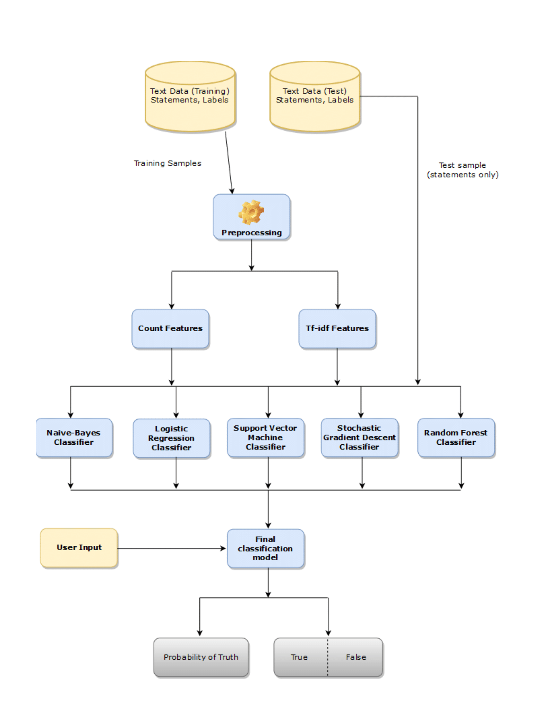
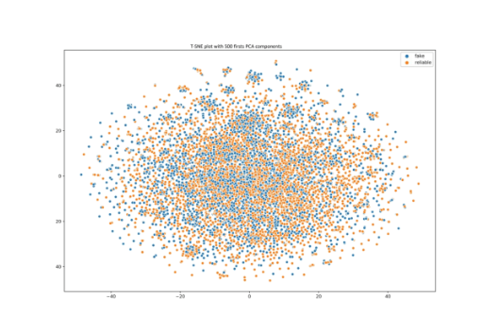
NLTK
T-SNE plot with 500 first PCA components

Slide 8
Related Work.
There are two main categories of state of the art that are interesting for this work:
previous work on fake news detection and on general text classification. Works on fake news detection is almost in existent and mainly focus in 2016 US presidential elections or does not use the same features. That is, when this work focus on automatic features extraction using machine learning and deep learning, other works make use of hand-crafted features, such as psycholinguistic features which are not the goal here. Current research focus mostly on using social features and speaker information in order to improve the quality of classifications.
In addition to texts and social features, Yang used visual features such as
images with a convolutional neural network. Wang also used visual features for classifying fake news but uses adversarial neural networks to do so.

Slide 9
Data Preprocessing
The code reads in three CSV files - test, train, and valid. The data is then observed using the data_obs() function, which displays the size and head of each dataset. create_distribution() function is used to visualize the distribution of the classes in the datasets using a countplot. Additionally, the data_qualityCheck() function is used to check for any missing values in the datasets and display information on the datasets
The process_data() function is included to preprocess the text data by converting all words to lowercase, stemming the words, and removing stop words. However, it is currently commented out and not utilized in the code.

Slide 10
TF-IDF
TF-IDF (Term Frequency Inverse Document Frequency) is a numerical statistic that is commonly used in natural language processing (NLP) and information retrieval to represent the importance of a term in a document or a corpus.The term frequency is the number of times a term appears in a document, while the inverse document frequency is a measure of how rare a term is in the corpus.
A term that appears frequently in a document but rarely in the corpus as a whole is likely to be more important to that document than a term that appears frequently in both the document and the corpus.
To calculate the TF-IDF score for a term in a document, we multiply the term frequency by the inverse document frequency.
The inverse document frequency is typically calculated as the logarithm of the total number of documents in the corpus divided by the number of documents that contain the term.
TF-IDF scores are used to represent the importance of a term in a document or a corpus. They are often used as features in machine learning models for NLP tasks such as text classification, clustering, and information retrieval.

Slide 11
N-grams Creation
The n-gram feature extraction is a way of breaking down text into smaller chunks of contiguous words to capture more information about the context. For example, a bigram (n=2) for the sentence "The cat sat on the mat" would be "The cat", "cat sat", "sat on", "on the", "the mat".
In the program, a TF-IDF vectorizer is used to create n-gram features, where stop words (commonly used words like "the" and "and") are removed, and n-grams of size 1 to 4 are created to capture the context and relationships between different words in the text.
This technique helps in identifying important words and phrases in the text, which can then be used to detect fake news by comparing with a pre-labeled dataset.

Slide 12
POS TAGGING
Part-of-speech (POS) tagging is the process of labeling words in a sentence with their corresponding part of speech, such as noun, verb, adjective, etc.
POS tagging can be used to identify the usage of specific parts of speech that are commonly associated with fake news. For example, fake news articles may contain more adjectives, adverbs, or exaggerated language than real news articles. By analyzing the POS tags of the words in a given text, we can identify these patterns and use them to distinguish between real and fake news.
To perform POS tagging, a machine learning model is trained on a corpus of labeled data, where each word is annotated with its corresponding POS tag. The trained model can then be used to automatically assign POS tags to new, unlabeled text data.
In the program, a POS tagging model is trained on the Treebank corpus, and the resulting model is used to extract features from the news articles for fake news detection.

Slide 13
Naive-Bayes
Naive bayes is a simple algorithm that assumes that the features are
independent and uses the Bayes theorem to calculate the probabilities of each class.
The algorithm transforms news statements into word frequency vectors and then uses a probabilistic classifier to label them as fake or real. It is trained and tested on different sets of news statements and its accuracy is evaluated by comparing the predicted and true labels.
In the Naive classifier we use the two functions NBCV and nb_clf
The classification analysis can be used to predict the probability of news article being fake or real.
Overall, the Naive Bayes algorithm is a popular and effective choice for text classification tasks, especially when dealing with large datasets.

Slide 14
Logistic Regression
Logistic regression is a popular and powerful algorithm that uses a logistic function to model the probability of each class.
Logistic Regression can handle both numerical and categorical features, and can also use n-grams or TF-IDF vectorization to capture the textual properties of the news.
We used logistic regression to classify news statements as true or false, based on their word counts. and built a pipeline that transforms the statements into word counts and applies the logistic function. The classifier achieved a mean accuracy score of 0.62 on the test data, which is slightly better than naive bayes
We used this algorithm because it is popular and powerful, and it can model the probability of each class. It can also handle binary or multiclass problems, and it can be easily tuned with different parameters. It is also fast and simple to implement with sklearn.

Slide 15
SVM Classifier
SVM (Support Vector Machine) is a type of machine learning algorithm that can be used for classification tasks, such as detecting fake news.
The SVM classifier is trained on a set of labeled news articles, where each article is represented by a set of features, such as the frequency of certain words or the presence of certain patterns of words.
To optimize the performance of the classifier, a grid search is performed to find the best combination of hyperparameters (such as the range of n-grams to consider and whether to use IDF weighting or not).
By tuning the hyperparameters using the grid search method, the performance of the SVM classifier is optimized to achieve the highest possible accuracy on the test data.
We used SVMs because they are effective in separating classes of data that may not be linearly separable in the feature space. Additionally, SVMs can handle high-dimensional feature spaces, which is useful when working with text data that has a large number of features (such as the bag-of-words representation).

Slide 16
SGD CLASSIFIER
SGD Classifier is a variant of the linear Support Vector Machine (SVM) that uses stochastic gradient descent optimization for the loss function. The algorithm works by iteratively updating the model parameters using small random batches of training data, which makes it efficient for large datasets.
The loss function used in the SGD Classifier is hinge loss. In addition to the hinge loss, the SGD Classifier use other loss functions as well, such as logistic loss (for binary classification) or softmax loss (for multiclass classification). It can also apply regularization to prevent overfitting.
The SGD Classifier is a versatile algorithm that can handle various types of data, including text, image, and numerical data. It has been widely used in natural language processing (NLP) tasks, such as text classification and sentiment analysis.

Slide 17
Random Forest
The feature selection and random forest classification. The feature selection step is done using the count vectorizer method, which converts the text data into a matrix of token counts. The random forest classifier is then trained using the transformed data with 200 estimators and 3 jobs for parallel processing.
The model is trained on the training dataset 'Statement' column and the 'Label' column is used as the target variable. The trained model is then used to predict the labels of the test dataset's 'Statement' column. Regression analysis can be used to predict the probability of a news article being fake or not.

Slide 18
Evaluating the results...
We evaluated the performance of these classifiers using the F1 score and found that the random forest classifier performed the best with an F1 score of 0.70.
However, we wanted to enhance the features by using term frequency weights with various n-grams, and we applied this technique to the same classifiers. We found that the random forest classifier still performed the best with an F1 score of 0.86.
We also performed K-fold cross-validation on all the classifiers, and the results showed that the random forest classifier with n-grams had the highest accuracy of 86%.

Slide 19
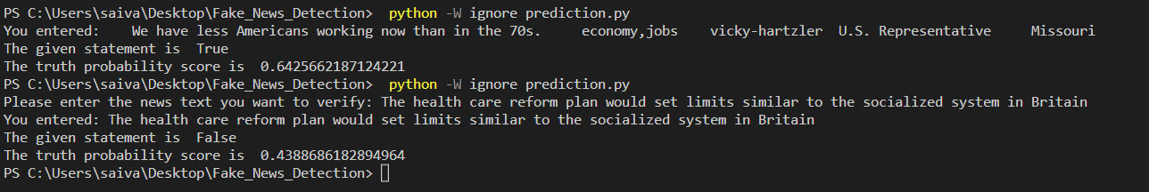
Output From Python

Slide 20
REFERENCES:
Jeffrey Gottfried and Elisa Shearer.News Use Across Social Medial Platforms 2016.Pew Research Center, 2016.
Craig Silverman and Lawrence Alexander. How teens in the balkans are dupingtrump supporters with fake news.Buzzfeed News, 3, 2016.
Craig Silverman and Lawrence Alexander. How teens in the Balkans are dumping trump supporters with fake news. Buzzfeed News 3.
Rong- En Fan, Kai - Wei Chang, Cho -Jui Hsieh, Xiang - Rui Wang, and Chih- Jen Lin. Liblinear: A library for large linear classification. J. Mach. Learn. Res. , 9:1871 – 1874..
Stephen Robertson. Understanding inverse document frequency: On theoretical arguments for idf.
Harry Zhang. The Optimality of Naive Bayes. page 6.
Sepp Hochreiter and Ju ̈rgen Schmidhuber. Long short-term memory. Neural Computation, 9:1735 1780.
Kai Shu, Amy Sliva, Suhang Wang, Jiliang Tang, and Huan Liu. Fake news detection on social media: A data mining perspective. ACM SIGKDD Explorations Newsletter, 19(1):22 –36.

Slide 21


